Slide 1
Department of CSE
COURSE NAME: Data science
COURSE CODE: 24AD3107
Topic:
Box Plots and Outlier Analysis
Session - 7

Slide 2
AIM OF THE SESSION
To familiarize students with the basic concept of Box plots and Outliers.
INSTRUCTIONAL OBJECTIVES
This Session is designed to: Introduction to Box Plots and Finding Outliers.
LEARNING OUTCOMES
At the end of this session, you should be able to: have knowledge on creating Box Plots and detecting outliers

Slide 3
Key Concepts
SESSION INTRODUCTION
Introduction to Box Plots
Calculating Quartiles
Introduction to Outliers
Finding Poutliers in a dataset

Slide 4
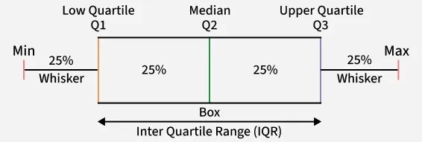
Box plot:A Box plot is a way to visualize the distribution of the data by using a box and some vertical lines. It is known as the whisker plot. A Box Plot is also known as a Box and Whisker Plot and it is a graphical tool used to understand the distribution of numerical data. It shows the median, quartiles and possible outliers in a simple visual form. It helps compare distributions between groups with ease.
  multiple groups effectively.
  Identify outliers quickly and visually.
  Reveal data symmetry or skewness at a glance.
  Show variability clearly even for large datasets.
  Provide compact summaries of data using quartiles and range.
  Useful for comparing multiple groups or categories.
The data can be distributed between five key ranges, which are as follows:
Minimum: Q1-1.5*IQR
1st quartile (Q1): 25th percentile
Median:50th percentile
3rd quartile(Q3):75th percentile
Maximum: Q3+1.5*IQR
Here IQR represents the InterQuartile Range which starts from the first quartile (Q1) and ends at the third quartile (Q3).

Slide 5
In the box plot, those points which are out of range are called outliers. We can create the box plot of the data to determine the following:
The number of outliers in a dataset
Is the data skewed or not
The range of the data
The range of the data from minimum to maximum is called the whisker limit.

Slide 6
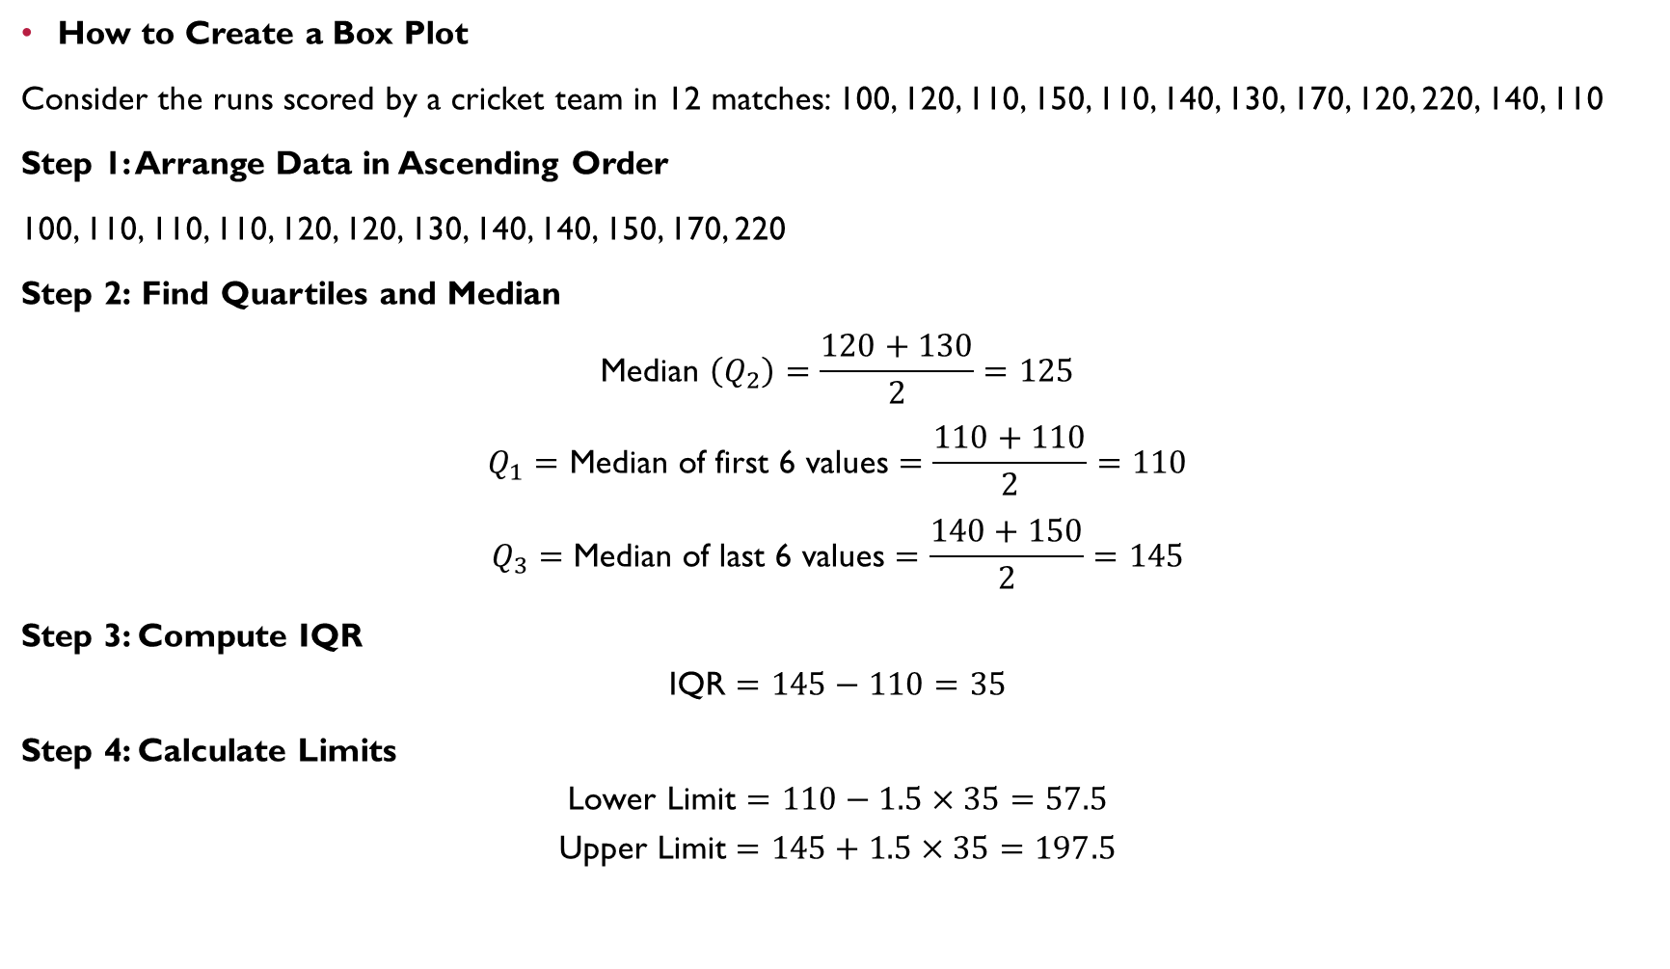
How to Create a Box Plot
Consider the runs scored by a cricket team in 12 matches: 100, 120, 110, 150, 110, 140, 130, 170, 120, 220, 140, 110
Step 1: Arrange Data in Ascending Order
100, 110, 110, 110, 120, 120, 130, 140, 140, 150, 170, 220
Step 2: Find Quartiles and Median
$$\text{Median }\left(Q_{2}\right)=\frac{120+130}{2}=125$$
$$Q_{1}=\text{Median of first 6 values}=\frac{110+110}{2}=110$$
$$Q_{3}=\text{Median of last 6 values}=\frac{140+150}{2}=145$$
Step 3: Compute IQR
$$\text{IQR}=145−110=35$$
Step 4: Calculate Limits
$$\text{Lower Limit}=110−1.5×35=57.5$$
$$\text{Upper Limit}=145+1.5×35=197.5$$

Slide 7
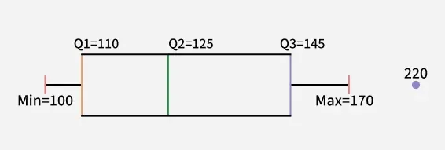
Step 5: Identify Min, Max and Outliers
Minimum (within limit) = 100
Maximum (within limit) = 170
Outlier = 220
This information is then used to draw the box plot.
Compare Outliers
Outliers appear as points beyond whiskers.
More outliers indicate irregular or inconsistent data.
Fewer outliers suggest more stable and predictable values.

Slide 8
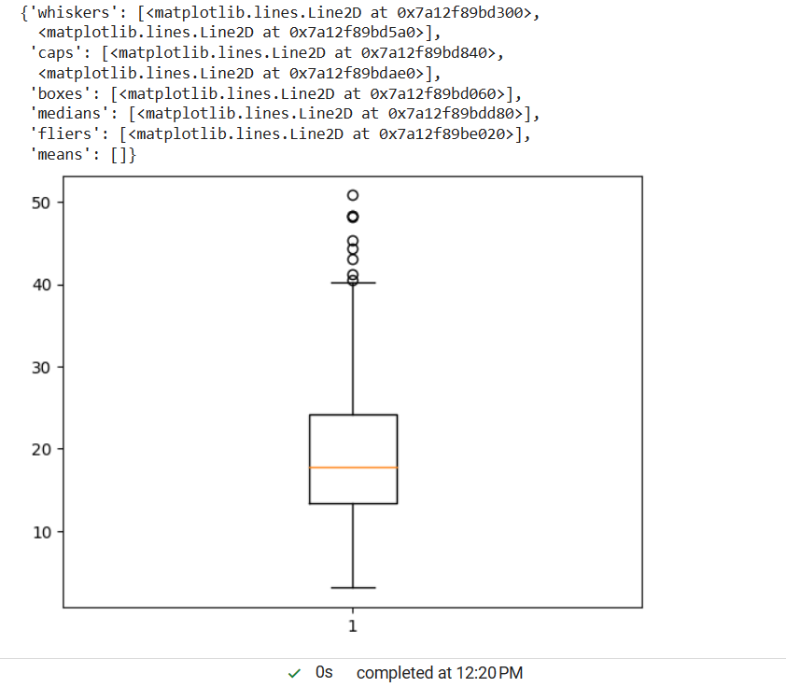
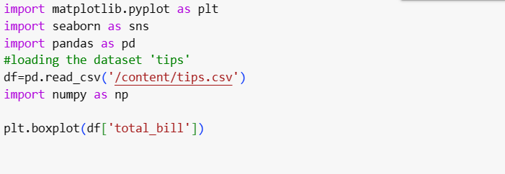

Slide 9
Detectection and removal of outliers:
An Outlier is a data-item/object that deviates significantly from the rest of the (so-called normal)objects. They can be caused by measurement or execution errors. The analysis for outlier detection is referred to as outlier mining. There are many ways to detect the outliers, and the removal process is the data frame same as removing a data item from the panda’s data frame.
Visualizing Outliers Using Box Plot
It captures the summary of the data effectively and efficiently with only a simple box and whiskers. Boxplot summarizes sample data using 25th, 50th, and 75th percentiles. One can just get insights(quartiles, median, and outliers) into the dataset by just looking at its boxplot.

Slide 10
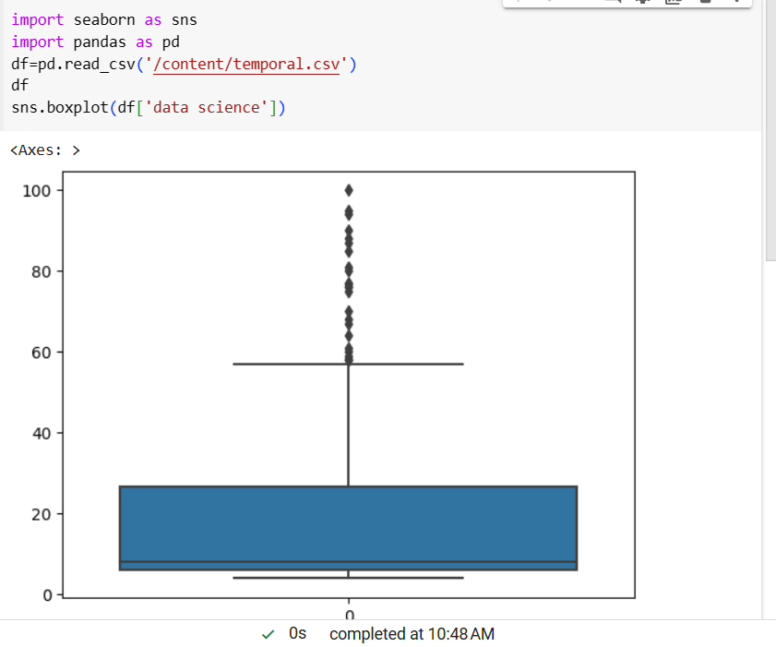
In the above graph, can clearly see that values above 60 are acting as outliers.

Slide 11
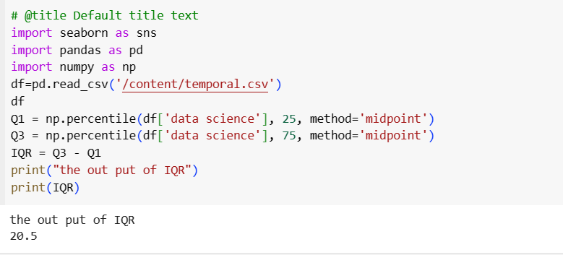
IQR (Inter Quartile Range)
IQR (Inter Quartile Range) Inter Quartile Range approach to finding the outliers is the most commonly used and most trusted approach used in the research field.
Syntax: numpy.percentile(arr, n, axis=None, out=None)
arr :input array.
n : percentile value. IQR = Quartile3 – Quartile1

Slide 12
To define the outlier base value is defined above and below dataset’s normal range namely Upper and Lower bounds, define the upper and the lower bound (1.5*IQR value is considered) :
upper = Q3 +1.5*IQR
lower = Q1 – 1.5*IQR
In the above formula as according to statistics, the 0.5 scale-up of IQR (new_IQR = IQR + 0.5*IQR) is taken, to consider all the data between 2.7 standard deviations in the Gaussian Distribution.

Slide 13
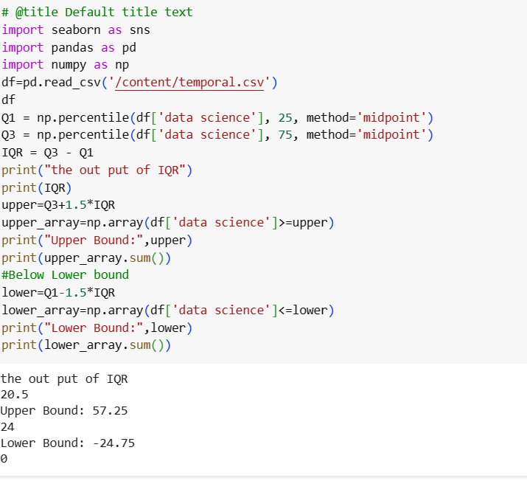

Slide 14
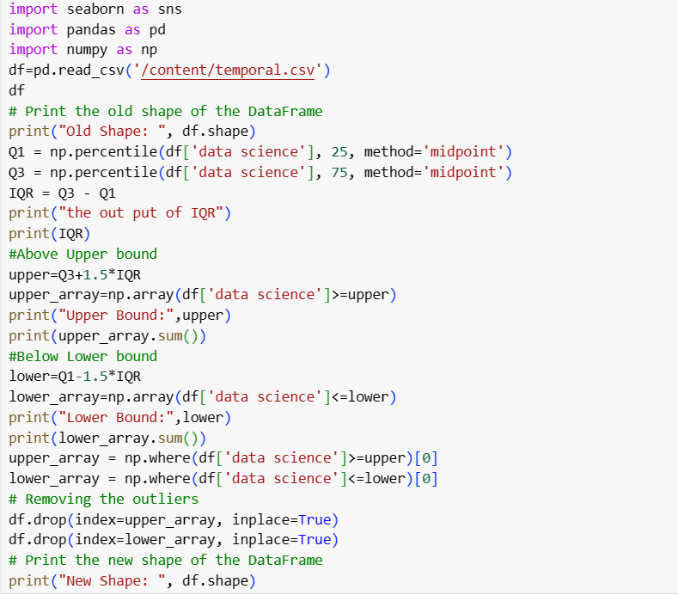

Slide 15
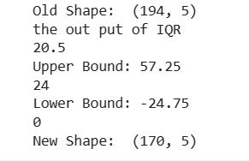

Slide 16
REFERENCES FOR FURTHER LEARNING OF THE SESSION
Text Books:
Introduction to Data Science- A Structured Methodology,Goran trajkovski.
Data Science from Scratch- Joel Grus - O’Reilly - 2015
Practical Statistics for Data Scientists - Peter Bruce, Andrew Bruce & Peter Gedeck - O’Reilly - 2020
Data Science and Machine Learning (Mathematical and Statistical Methods) - Dirk P. Kroese, Zdravko I. Botev, Thomas Taimre, Radislav Vaisman- Chapman and Hall/CRC - 2025
Foundations of Data Science - Avrim Blum, John Hopcroft, and Ravindran Kannan - Cambridge University Press – 2020
Reference Books:
R1.Data Science and Its Applications by Aakanksha Sharaff and G. R. Sinha.
R2. Introducing Data Science Big Data, Machine Learning, and more using Python tools. by Davy cielen, Arno D.B. Meysman and Mohamed Ali.

Slide 17

THANK YOU
Team – DS

